Slide 1

SandwichStory
The Sandwich Guys
July 2017
Alex Williamson - Product Owner
Christopher Hahn
David Stewart
Celine Peña
Davie Truong
Matthew Diep
Notes:
Chris

Slide 2
Problem/Application Domain
What motivated our choice of project?
Create something that’s simple but useful
Gain experience manipulating data being uploaded/downloaded from database
Work with data stored locally on device
Work with Android Studio
Notes:
Chris

Slide 3
Goals
Goals set out to achieve:
Working app that stores data locally and in database ✓
App that allows you to create/save your own recipes and view other’s recipes ✓
Learn Scrum practices to work effectively as a team ✓
App that provides the user with nutritional information
App that allows the user to filter through recipes based on dietary restrictions
Notes:
Chris

Slide 4
Greatest Challenges & Accomplishments
Development Product:
Database
Images/Permissions
Saving data locally
Development Process:
Communication
Lack of planning
Working with new technology
Scrum techniques
Notes:
Database: (David) This was a challenge since we first had to correctly set up google App engine and understand how Web2py works. When we started developing code for the database, the code was very sensitive and we would often encounter internal server errors even just by making very small changes that we thought would not break the code. We also worked without having any debugging tools since we had problems setting up a local webserver on our computers, so overall backend development was very time consuming.
Images:(Davie) is just gonna wing it..
Saving data(Matthew) - Understanding the frontend/backend relationship…. sending information from front-end to backend was challenging since we continually had database problems
Development Process:
Communication: We did not communicate well in the beginning. As a consequence, we had some inconsistencies in variable naming which created bugs that were difficult to detect. Also, lack of communication made it difficult to know exactly how each other were implementing features.
Lack of planning: We did not have a very detailed plan from the start. We had general ideas of what we wanted but did not sit together and plan how exactly each feature would be implemented.
Working with new technology: 3/6 of the team had never used Android Studio. This meant that we had to spend a good portion of our first sprint learning how to use the software.
Learning scrum too late: We were only able to properly implement the full scrum process toward the end of our sprints.

Slide 5
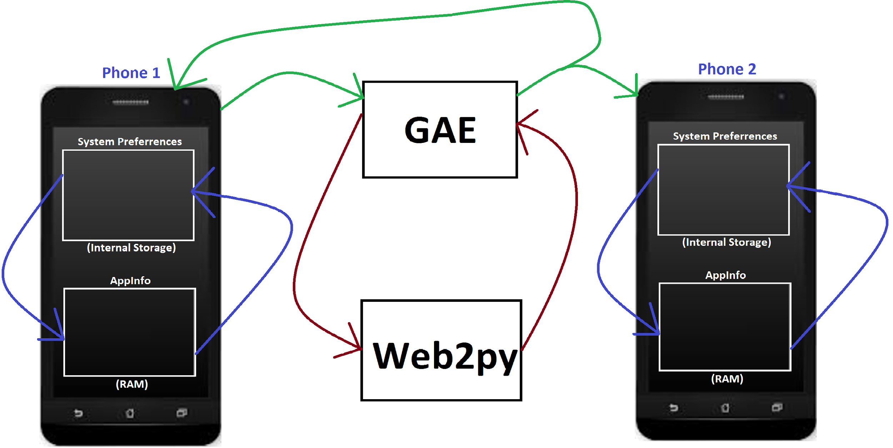
System Overview/Diagram
Notes:
Alex

Slide 6
Technologies We Used
Android Studio: IDE used to create app
Web2py: Where backend code is written
Google App Engine: Hosts the web2py database
Notes:
Alex brushes over it

Slide 7
Project Management Techniques Used
Democracy/Unanimous agreement
Planning Poker
Burn up chart
Scrum board
Daily scrum meetings
Notes:
Celine

Slide 8
Things We Enjoyed
Learning to use Android Studio
Working in a self-motivated team
Implementing pair programming
Scrum Meetings
Notes:
Celine

Slide 9
Things We Didn’t Enjoy
Having to do extensive documentation
Rushed timeframe
Notes:
Matthew

Slide 10
Lessons Learned
What worked:
Pair programming
Stand up meetings
Frequent meetings
Notes:
Davie

Slide 11
Lessons Learned
What didn’t work:
Being overly ambitious
Segregated frontend and backend teams
Notes:
Davie
1: Wasted time

Slide 12
Lessons Learned
Things we wish we had done:
Used localhost for the database
Got outside help more
Had a faster pace at the start
Started with a coding style guide
Notes:
David (Best for last)

Slide 13
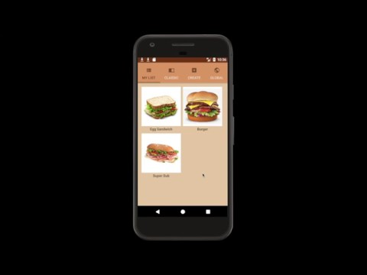
Notes:
Home - Create - Save to Library - show home - show sandwich - go to library - download - detail from home of sandwich download - edit - details - delete -home - end with our traditionals

